Slide 1
Revising and Editing: Organization
SHSAT English - Week Three
Notes:
Cr: Arin Faruque for the ELA qs and as

Slide 2
Aim: Understand how to approach Organization questions on the SHSAT
Do Now: What are transition words used for? Can you name a few examples of transition words?

Slide 3
01
Organization questions
Organization questions require you to read specific text and decide how to most clearly convey the author’s intended meaning.

Slide 4
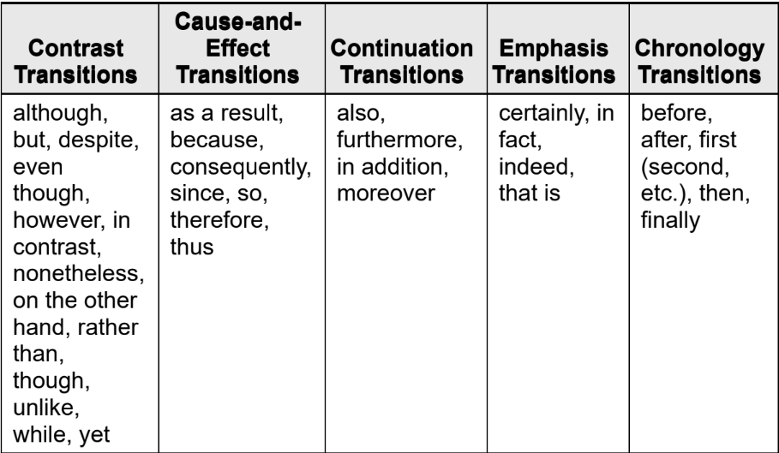
Transitions
Writers use transitions to show relationships such as contrast, cause and effect, continuation, emphasis, and chronology (order of events). Here are the main types of transitions:
To answer transition questions, determine the author’s intended meaning and select the transition that best conveys this information. For example, if the author is mentioning two opposing ideas, a contrast transition should be used.

Slide 5
Combining Sentences
These questions ask you to combine sentences to clarify the relationship between ideas and may be standalone or accompany a passage. Your goal is to ensure that information and ideas are logically conveyed using correct grammar.
To answer Combining Sentences questions, process of elimination is important. Eliminate any option that creates a comparison or relationship the writer did not intend. For example, if a writer presents two related ideas that convey similar information, you can cross out choices that use contrast transitions such as “but,” “however,” or “although.”

Slide 6
Moving sentences
→ These questions task you with moving a sentence to improve the organization of a paragraph within the passage (or a paragraph within a passage, though this is rare).
→ To answer these questions effectively, evaluate each answer choice by looking for keywords that indicate where the sentence should be placed.
→If the sentence you are moving starts with “For example,” you need to place the sentence after a statement that it would best support. If the sentence includes a chronological transition such as “next” or “after that,” it must be placed in the most logical spot within a sequence of events the writer is discussing.

Slide 7
Moving sentences
Other Question Types:
The question will ask you for the best place to insert a new sentence.
→ Your approach in both cases should be the same: Reread the paragraph, read the sentence given, and see if there is anywhere that the sentence could be placed to better link the sentence before and after.

Slide 8
Moving Sentences (cont.)
To approach this type of question, look for specific clues that indicate the best organization. Common clues include:
Chronology: If the information is presented in order by the time when it occurred, place the sentence within the correct time frame.
Explanation of a term or phrase: If the passage features a term, the writer will explain what it is before using the term in other contexts.
Introduction of a person: If the passage introduces someone, such as Grace Hopper, the writer will first refer to the person by first and last name before referring to the person by either first name (Grace) or last name (Hopper) only.
Examples: A general statement is often followed by support in the form of examples.
Logic: Transition words such as “however,” “also,” “furthermore,” and “therefore” may signal the logic of the paragraph. For example, the word “therefore” indicates that a conclusion is being drawn from evidence that should logically come before it.

Slide 9
Organization Practice

Slide 10
Select the transition that most accurately reflects the author’s intended meaning. What type of transition is it?
Notes:
A. therefore; cause and effect
B. Although; contrast
C. before; chronology
D. indeed; emphasis
E. furthermore; continuation

Slide 11
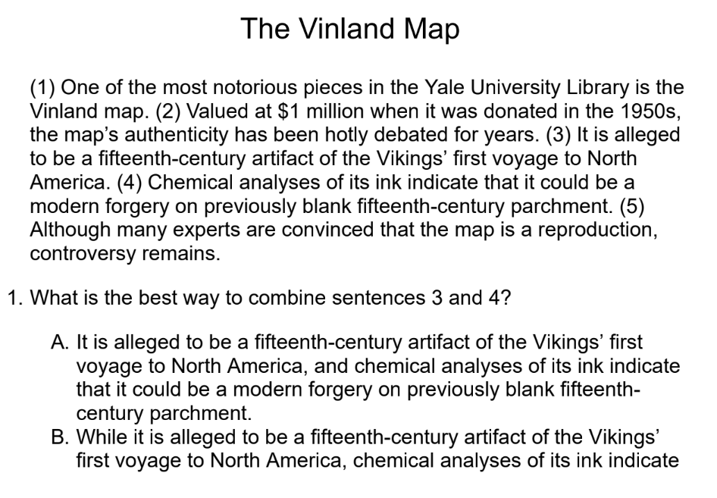
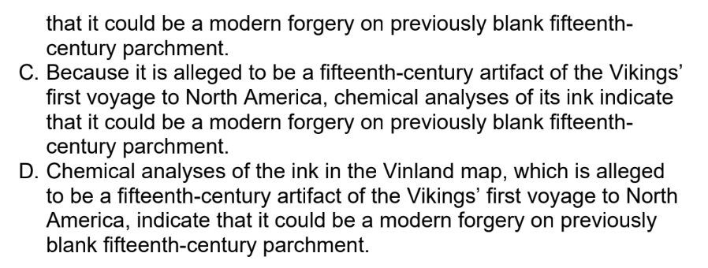
What type of question does the following question stem belong to? What is the correct answer and why?
Notes:
Combining sentences
B

Slide 12
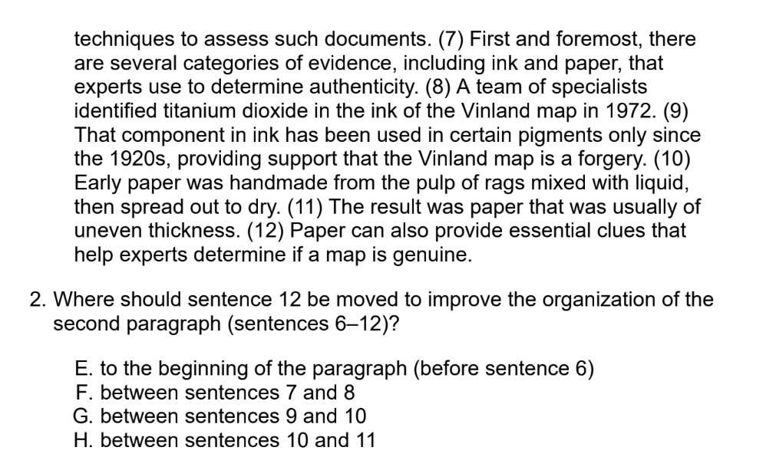
What type of question does the following question stem belong to? What is the correct answer and why?
Notes:
Moving sentences
G

Slide 13
What type of question does the following question stem belong to? What is the correct answer and why?
Notes:
Transitions
B

Slide 14
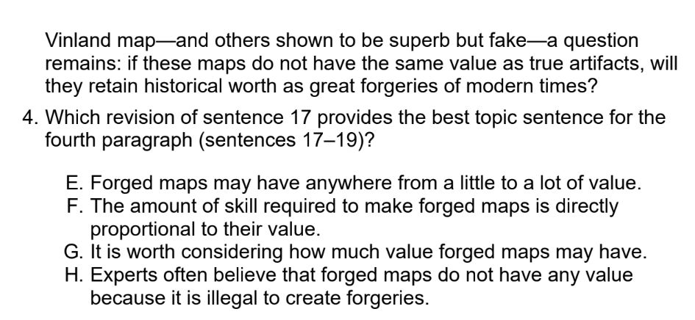
What is the correct answer and why?
Notes:
G

Slide 15
02
Topic Development questions

Slide 16
Overview and Approach
These questions test your ability to determine why a passage is written and whether particular information helps accomplish that purpose. Some task you with adding or replacing sentences to better support the information in the passage, while others ask you to delete information that is not relevant to the passage.
How to answer Topic Development questions:
Take the time to determine the writer’s intended purpose before selecting an answer (think about the main claim of the passage!). Correct answers will include information that the writer would agree is relevant and fits well within the context of the passage.
To answer questions about adding or replacing sentences, first eliminate answer choices that do not reflect the writer’s purpose. Then, choose the most correct and relevant option.
To answer questions that require deleting information, determine which sentence does not specifically relate to the development of the passage.
The passage should flow smoothly and logically once the irrelevant sentence is removed.

Slide 17
Topic Development Practice

Slide 18
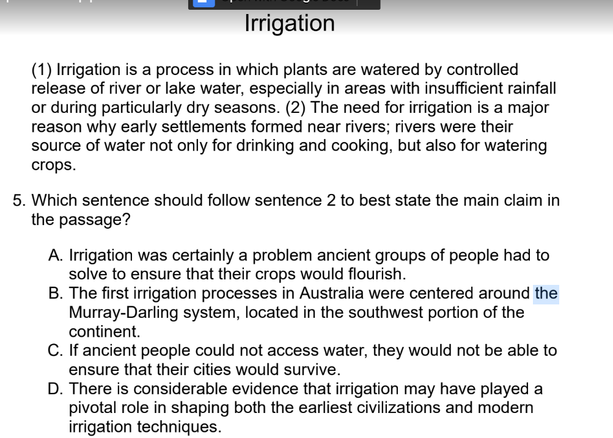
What is the correct answer and why?
Notes:
D

Slide 19
What is the correct answer and why?
Notes:
H

Slide 20
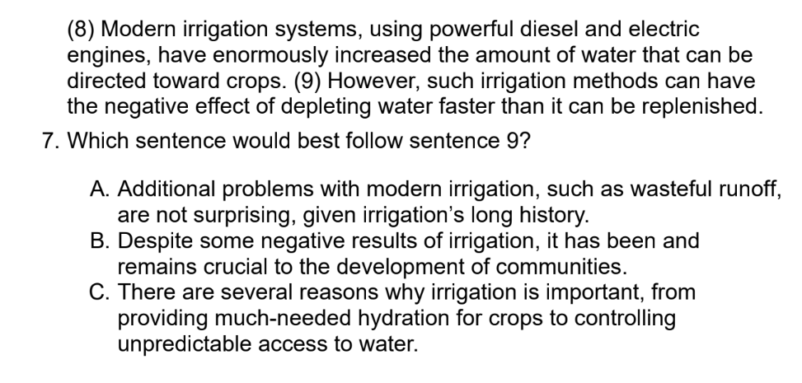
What is the correct answer and why?
Notes:
B

Slide 21
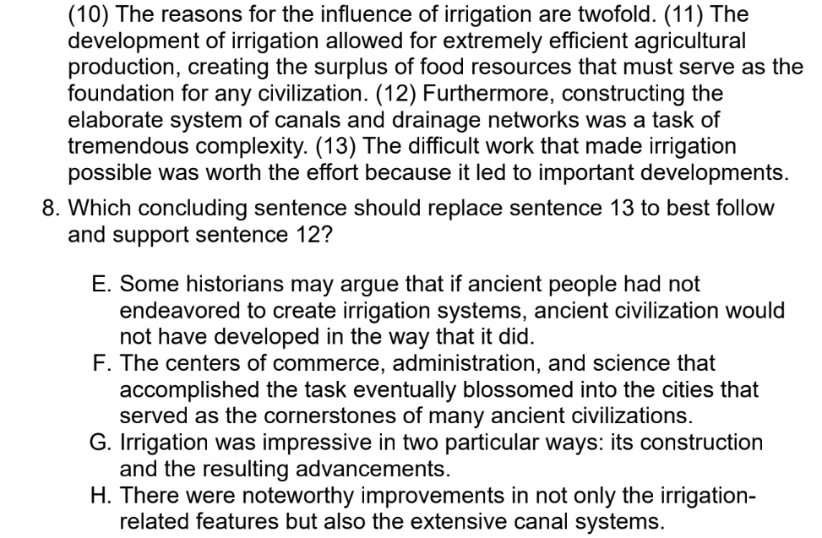
What is the correct answer and why?
Notes:
F

Slide 22
General Practice

Slide 23
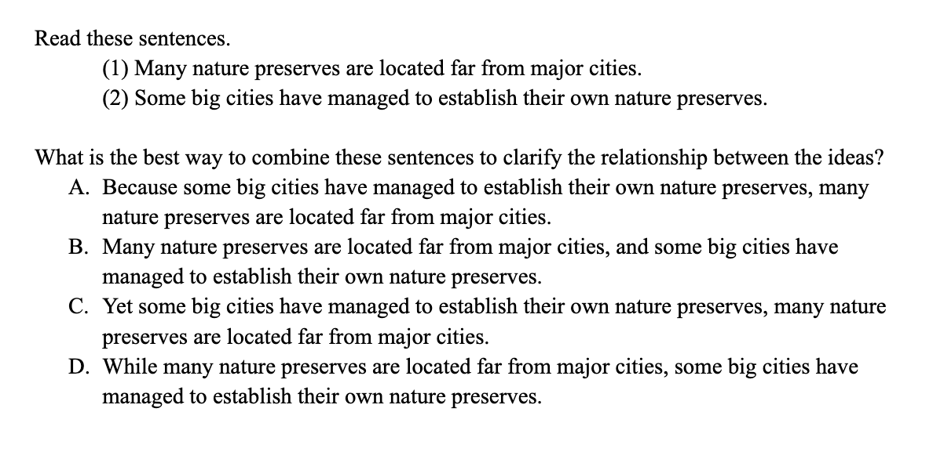
What type of question does the following question stem belong to? What is the correct answer and why?
Notes:
Combining sentences
D

Slide 24
What type of question does the following question stem belong to? What is the correct answer and why?
Notes:
Combining sentences
B

Slide 25
Click here for the passage:
Link to the Passage
Take a few minutes to read the passage:
(try to do a mix of skimming and reading for grammar passages!)

Slide 26
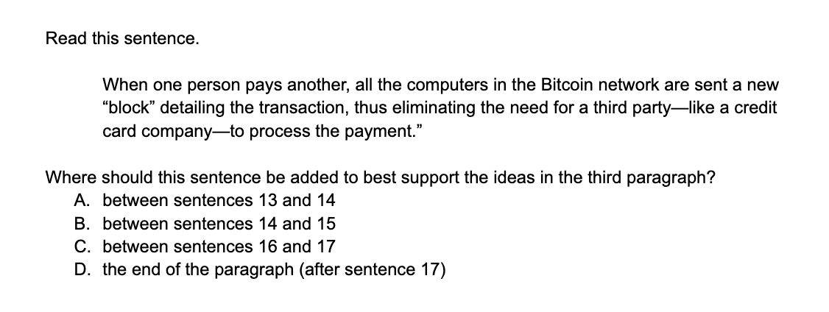
What type of question does the following question stem belong to?

Slide 27
Correct Answer:D
Answering this question correctly requires knowing what the main idea of the third paragraph is. This paragraph describes how Bitcoin works today—its use as a token and its collective network.
The sentence that you are given explains how the blockchain works, so find the sentence in which the blockchain is introduced: sentence 17. This sentence can logically follow sentence 17 to offer supporting evidence about the blockchain. The correct answer is (D).

Slide 28
What type of question does the following question stem belong to?

Slide 29
Correct Answer: B
Sentence 12 says “What’s unique about Bitcoin is not the currency itself, but rather the network it lives on.” The first part of the paragraph describes what Bitcoin is and then describes the Bitcoin network.
The key sentence to notice is sentence 14, which says that Bitcoin itself is “not revolutionary.” “Revolutionary” is a relative of “unique”, making it a good match. It would logically make sense to call Bitcoin itself not revolutionary, and then explain what might be revolutionary or unique. Thus, sentence 12 flows nicely after sentence 14, so answer choice B is correct.
For these types of questions, always reread the whole paragraph and look for shifts in ideas throughout the paragraph.

Slide 30
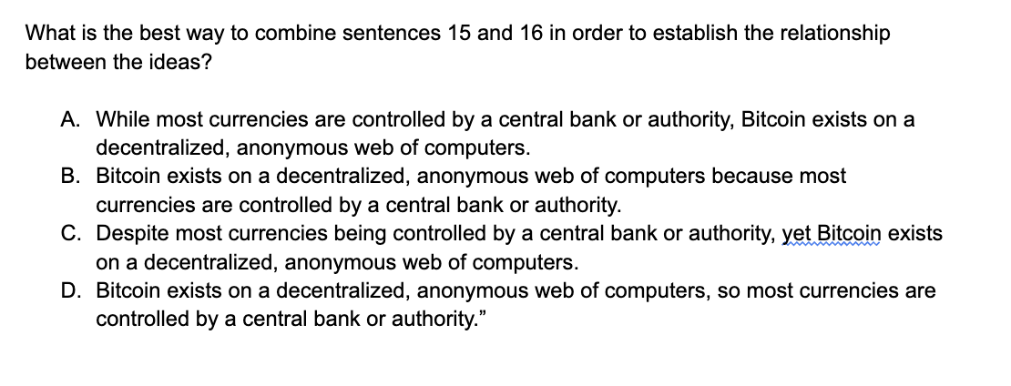
What type of question does the following question stem belong to?

Slide 31
Correct Answer: A
First, understand that relationship: most currencies are run by a central bank, but Bitcoin is totally decentralized and run by an anonymous network. Eliminate (B) and (D) as they’ve suggested causality with “because” and “so.”
Bitcoin is not decentralized because other currencies are controlled by a central bank. And most currencies are not controlled by a central bank as a result of Bitcoin being decentralized; that’s not what the passage says.
Down to two! Eliminate (C) because the “yet” in the sentence does not work with the “despite” also being there. Therefore, choose A.
Remember that when combining sentences, you must combine them without changing the relationship between the two sentences!

Slide 32
What type of question does the following question stem belong to??

Slide 33
Correct Answer: D
Look at the passage and notice that sentence 6 continues to explain the pre-Bitcoin method of sending money digitally. The passage says banks can monitor transactions and charge fees, so look for an agreement transition word.
Cross off the disagreement transition words in (A), (B), and (C). The correct answer is (D).
When thinking about which transition word to add, it’s helpful to first decide whether it would be an agreement or disagreement word.

Slide 34
Geometry: Perimeter, Area, and Volume; the Coordinate Plane
SHSAT Math - Week Three
Notes:
Cr: Arin Faruque for the ELA qs and as

Slide 35
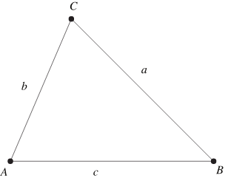
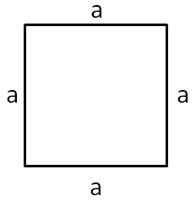
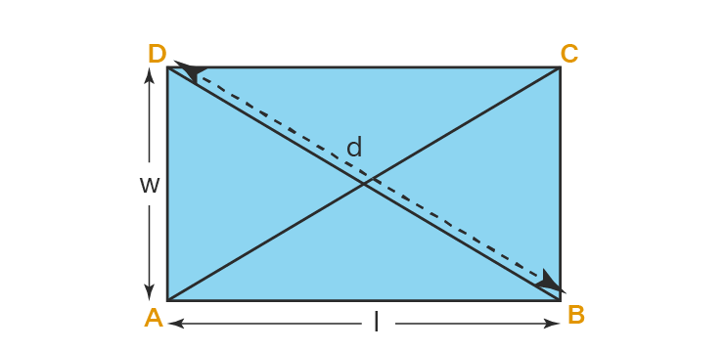
Perimeter
Triangle : Add the measure of the 3 sides a+b+c
Square/Rhombus: 4*measure of one side 4a
Rectangle/Parallelogram: 2*sum of width and length 2(l+w)

Slide 36
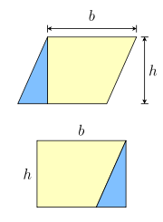
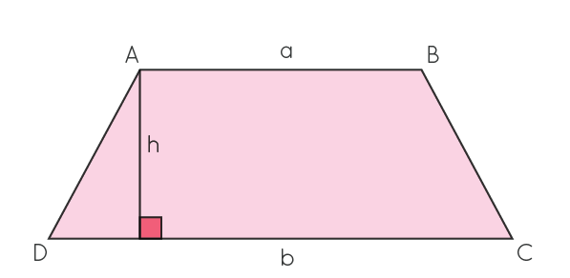
Area
Triangle: base*height/2 1/2bh
Square: side*side a^2
Rectangle: length*width lw
Parallelogram: base*height bh
Trapezoid: Sum of the two bases*h/2 1/2(a+b)h

Slide 37
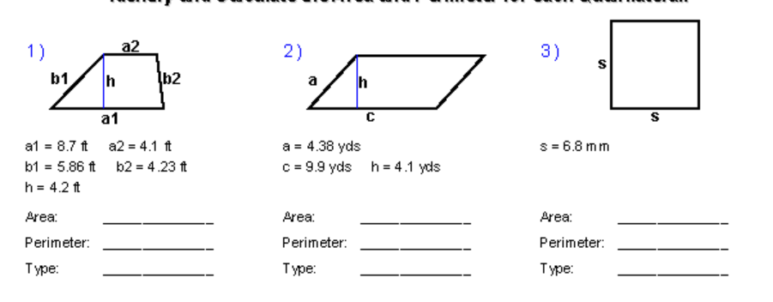
Practice
Notes:
1 A=26.88
P=23.49
2. P= 28.56
A=40.59
3.A = 46.24
P=27.2

Slide 38
The Coordinate Plane
Horizontal: x-axis
Vertical y-axis
A location is given in parenthesis in the form (x, y), where x is the location of the point horizontally, and y is the location of the point vertically.
For example, (-3, 2)
The two axes intersect at the origin, which is considered (0, 0)
Towards the right, x increases
Upwards, y increases

Slide 39
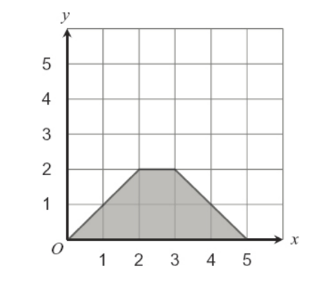
Using the coordinate plane
Often, you’ll be asked to find the area or perimeter of a figure on the coordinate plane. Use your geometry knowledge to answer these questions.
Example: Find the area of the following figure.

Slide 40
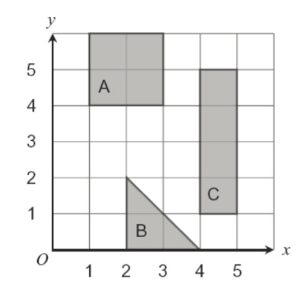
Practice
Find the area of A, B, and C.

Slide 41
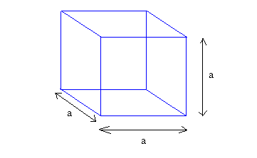
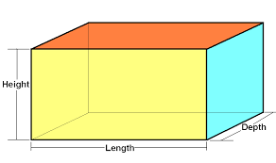
Volume
The amount of space a shape contains.
Cube: side*side*side a^3
Cuboid/Rectangular Prism: length*width*height lwh

Slide 42
Practice
Find the volume of the following figures.
Notes:
84
24

Slide 43
Thanks! Any Questions?

